Slide 1
Task 11:
Forces & Vehicle Safety
by Ciara Falaniko

Slide 2
Increasing the time of the collision / the time occupants take to stop
Crumple zones are areas of a vehicle that’ll crumple and bend in the event of a collision. Absorbing some of the energy from the impact stops it from being transferred to the vehicles occupants. Since engineers must remember that a various amount of variables including size, weight, and the stress that a vehicle will receive in a collision, it’s not easy designing crumple zones.
The best way to reduce the initial force with a given amount of mass/speed is to slow down the deceleration. The force of a collision can be reduced greatly by reducing the deceleration by merely a few tenths of a second.

Slide 3
B. Spreading the forces of impact over the largest possible area and ensuring stability of the vehicle
Crumple zones also help in redistributing a forces impact. It directs the force away from the occupants of the car because the force has to go somewhere.
Considering the force created in a car collision, whatever happens to the vehicle during impact and the people inside the vehicle will receive some of the force created during the collision. A certain amount of force is transferred to stationary/in motion objects.
The crumple zones that are created absorb as much force as possible to protect the components as well as the occupants inside the vehicle.

Slide 4
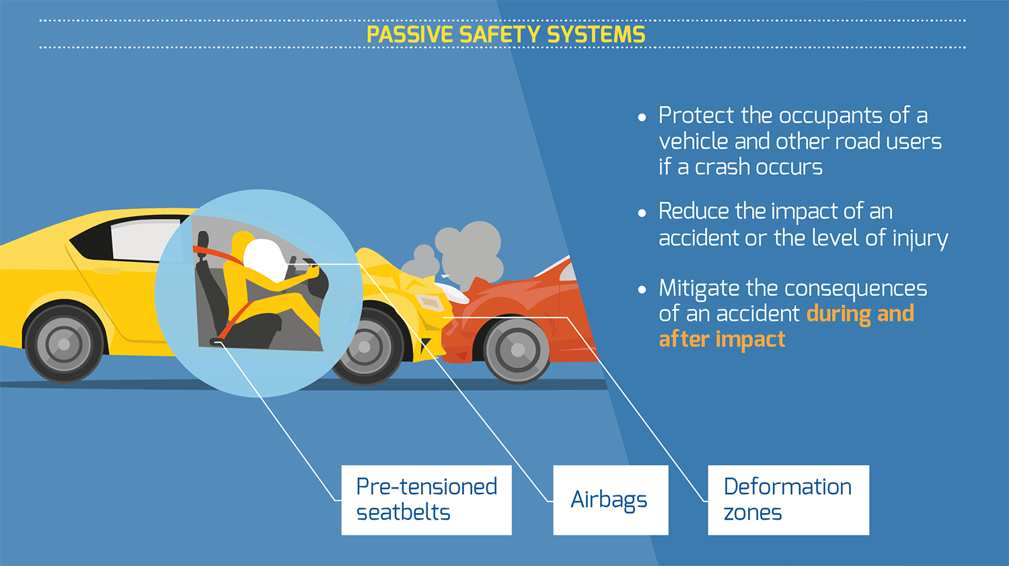
C. Minimising contact of the person with the interior of the vehicle
The seat belts in the vehicle keep the occupant from jostling/moving too much in the event of a sudden stop.
They’re designed to stretch slightly to allow movement which may occur in a collision. This lengthens the time it takes for the body’s movement to return to its original state, reducing it’s force.
Airbags also lengthens the time it takes for the heads momentum to return to its original position, which also reduces the forces acting on it as well as serving as a cushion to help prevent injuries that may occur to the head.

Slide 5
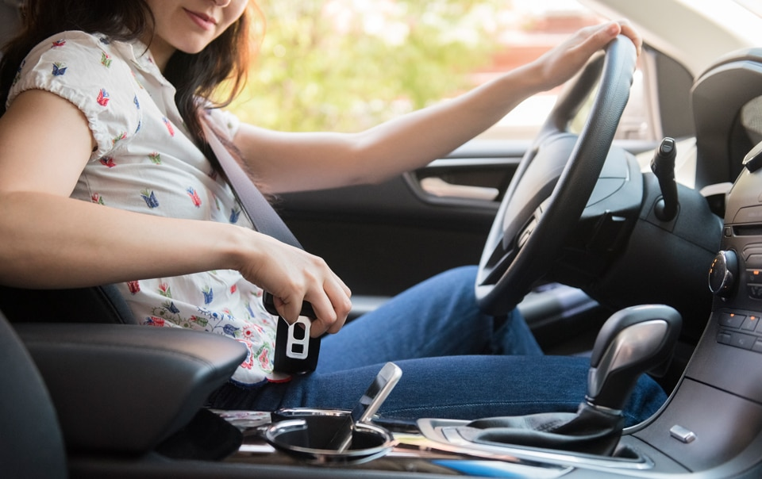
D. Keeping the person inside the vehicle
Newton's Law of Inertia states that an object will remain at rest or in a constant motion unless acted upon an unbalanced / external force.
The reason an occupant inside a vehicle doesn’t fly out of a car when in a collision is because the seat belt acts as an unbalanced force that stops the inertia, which in turn keeps the occupant in their current position.

Slide 6
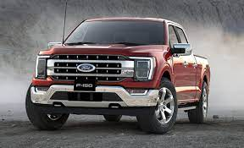
Chosen Vehicle: Ford F150
The standard features of the Ford F150 comes with automatic emergency braking as well as automatic high beams.
Standard safety features also include active lane control, reverse automatic emergency braking and blind spot monitors.

Slide 7
Safety features that comply with previously mentioned physics principle/s:
Seat belts fall into the category of Principle D as it coincides with the Law of Inertia. In the event of a possible collision, the automatic braking system that the Ford F150 contains would sense fast, oncoming vehicles coming into the direction of the car the occupant resides in. With this action, the car would automatically stop and with the seat belt fastened, it would stop the occupant from any harsh movement towards the interior of the vehicle.
Blind spot monitors may fall under Principles A and B. This is because they would be able to detect any oncoming objects or vehicles veering towards the vehicle, therefore making no use of the crumple zone as the collision was avoided.

Slide 8
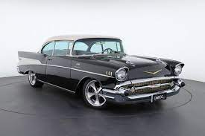
Chosen vehicle from before the 60’s:
1950’s Chevrolet Bel Air
The Chevrolet Bel Air didn’t have seatbelts or padded dashboards until 1956 which would’ve very dangerous in the event of a car crash as an occupants injuries would’ve been severe without them.
It also didn’t have crumple zones and airbags as well, which lowers the safety rate of an occupant in the vehicle significantly.

Slide 9
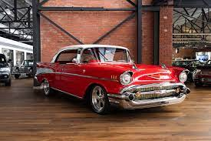
Unsafe features with physics principles:
With the lack of seatbelts, Principle D applies most to this. In the event of a collision, the occupant/s in the front seats would have flown out the car and been severely injured.
It also didn’t have airbags which complies with Principle C. Without the airbags, occupant/s may suffer injury due to the lack of cushioning from the hard interior of the vehicle.

Slide 10
The role of safety in a car design:
The role of safety in a design of a car provides the best possible chance of survival to the occupants who ride in the vehicle.
With the new technology and systems put into each new design that help the vehicle, this also helps the driver become more aware as well as save the vehicle itself if it were to get into a collision.
Cars are constantly developing into something safer and technologically helpful that it may save the occupants that are in it and it may even help avoid a collision all together.

Slide 11
Improvements that could be made with the principles of physics:
Suggest improvements using principles of physics

Slide 12
References:
2021 Ford F-150 Safety and Tech Features.
Chevrolet bel air safety features timeline

